Slide 1
Instructions
Font used: Arial
Please do not change fonts in the presentation.
To view the Drexel University brand style guide, click HERE.
Please refer to the style guide for guidance on logo placement, font and color use.
Modify, add and remove slide layout options:
Please add content, upload photos and remove slides as needed for your purposes.
To apply a different layout option to a single slide:
Select slide you’d like to edit. In the Home tab, click the dropdown arrow next to Layout and select a new slide layout to apply to the current slide.
If you have any questions, feel free to contact lebowdesign@drexel.edu.

Slide 2
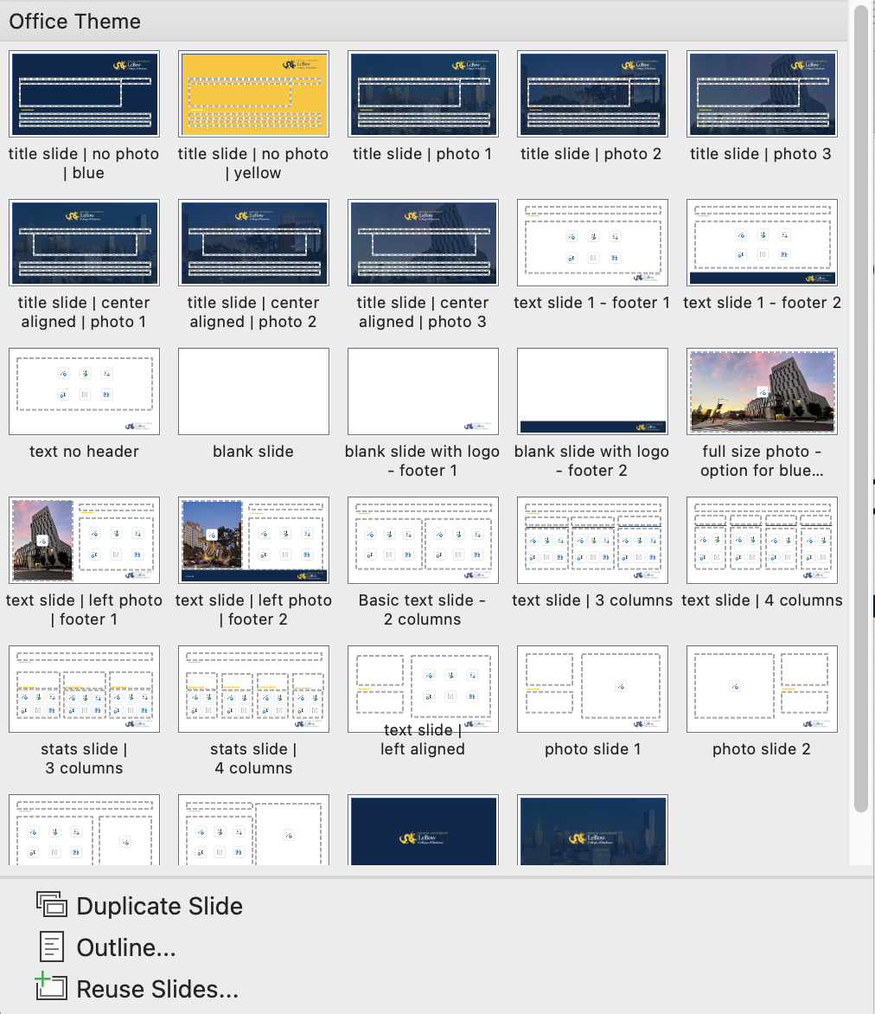
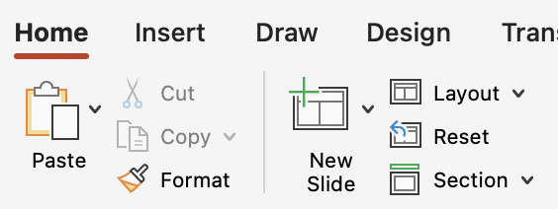

Adding new slides
To choose a layout and add a slide:
In the top toolbar, in the Home menu, select the arrow next to “new slide.”
this will display the pre-built layout options.
Click on the layout to add a new slide to your presentation.
To add the date or other information to the bottom left of the slides,
select Insert > Header & Footer.

Slide 3


Design elements to copy & paste
LeBow logos:
DO NOT stretch the height or width ratio of these logos.
Use the corner points to adjust size.
Yellow line:
Logo for light backgrounds:
Transparent blue overlay to place over photos:
Logo for dark backgrounds:

Slide 4
Title of presentation can go here
COLLEGE OR DEPARTMENT NAME CAN GO HERE
Subtitle of presentation can go here

Slide 5
Basic text slide – Layout Option 1
Slide copy can go here

Slide 6
Basic text slide – Layout Option 2 (no footer)

Slide 7
Photo background
If you would like a blue overlay on top of your photo: insert your photo using the button, go to the shape format menu, and select “send backward.”

Slide 8
Text slide with photo
You can insert your own photo using the button.

Slide 9
Photo slide - right
Insert photo using the button

Slide 10
Slide with text and small photo
Add text here
Insert photo using the button

Slide 11
Slide with text and large photo
Add text here
Insert photo using the button

Slide 12
Photo slide - left
Insert photo using the button

Slide 13
Statistics slide – 3 columns
#1
#1
80%
Best business school in Philadelphia
Best Online MBA in the US
Employed after graduation

Slide 14
Statistics slide – 4 columns
#1
#1
80%
$70K
Best Business School in Philadelphia
Best Online MBA in the US
Employed after graduation
Average
salary upon graduation

Slide 15
3 columns
Column 1
Column 2
Column 3
Item 1
Item 2
Item 3
Item 1
Item 2
Item 3
Item 1
Item 2
Item 3

Slide 16
4 columns
Column 1
Column 2
Column 3
Column 4
Item 1
Item 2
Item 3
Item 1
Item 2
Item 3
Item 1
Item 2
Item 3
Item 1
Item 2
Item 3

Slide 17
Title of presentation can go here
COLLEGE OR DEPARTMENT NAME CAN GO HERE
Subtitle of presentation can go here
XX/XX/20XX

Slide 18
Title of presentation can go here
COLLEGE OR DEPARTMENT NAME CAN GO HERE
Subtitle of presentation can go here
XX/XX/20XX

Slide 19
Title of presentation can go here
COLLEGE OR DEPARTMENT NAME CAN GO HERE
Subtitle of presentation can go here
XX/XX/20XX

Slide 20
Title of presentation can go here
COLLEGE OR DEPARTMENT NAME CAN GO HERE
Subtitle of presentation can go here
XX/XX/20XX

Slide 21
Title of presentation can go here
COLLEGE OR DEPARTMENT NAME CAN GO HERE
Subtitle of presentation can go here
XX/XX/20XX

Slide 22
Title of presentation can go here
COLLEGE OR DEPARTMENT NAME CAN GO HERE
Subtitle of presentation can go here
XX/XX/20XX

Slide 23
Title of presentation can go here
COLLEGE OR DEPARTMENT NAME CAN GO HERE
Subtitle of presentation can go here
XX/XX/20XX

